Slide 1
LSU Rowing
Bobbi Hebermehl

Slide 2
Team information
LSU Rowing is a Sports Club through the University Recreation Center at Louisiana State University. This means the team is not funded nor supported. Meaning every member has to pay semester dues so the team, or organization, can buy equipment, entry into competitions, and uniforms. To be able to maintain our equipment and make sure we are eligible to race, we have to grow our team numbers. The following slides demonstrate what year of students we should be recruiting heavily and in what semester, how long members stay once they joined, and predicting the teams future growth pertaining to our budget. This was determined through Python, SQL, R, and the visuals were done in Tableau and PowerBi.

Slide 3
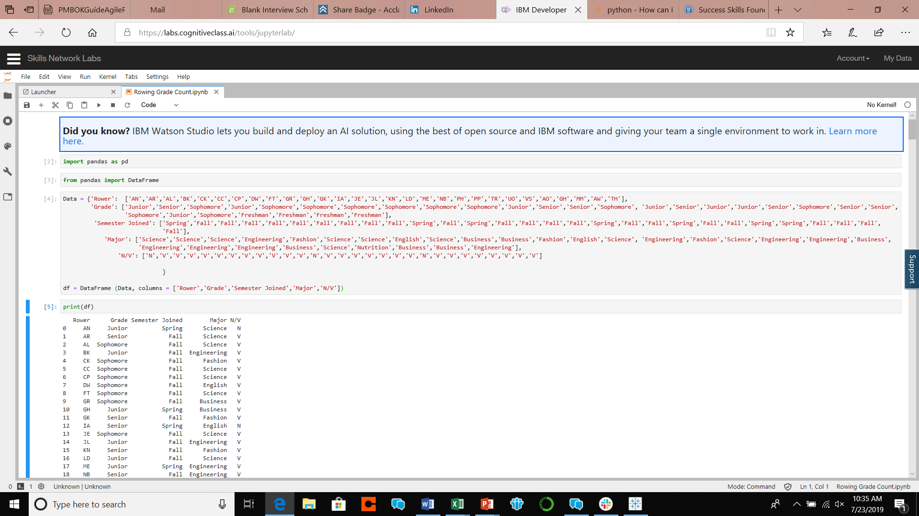
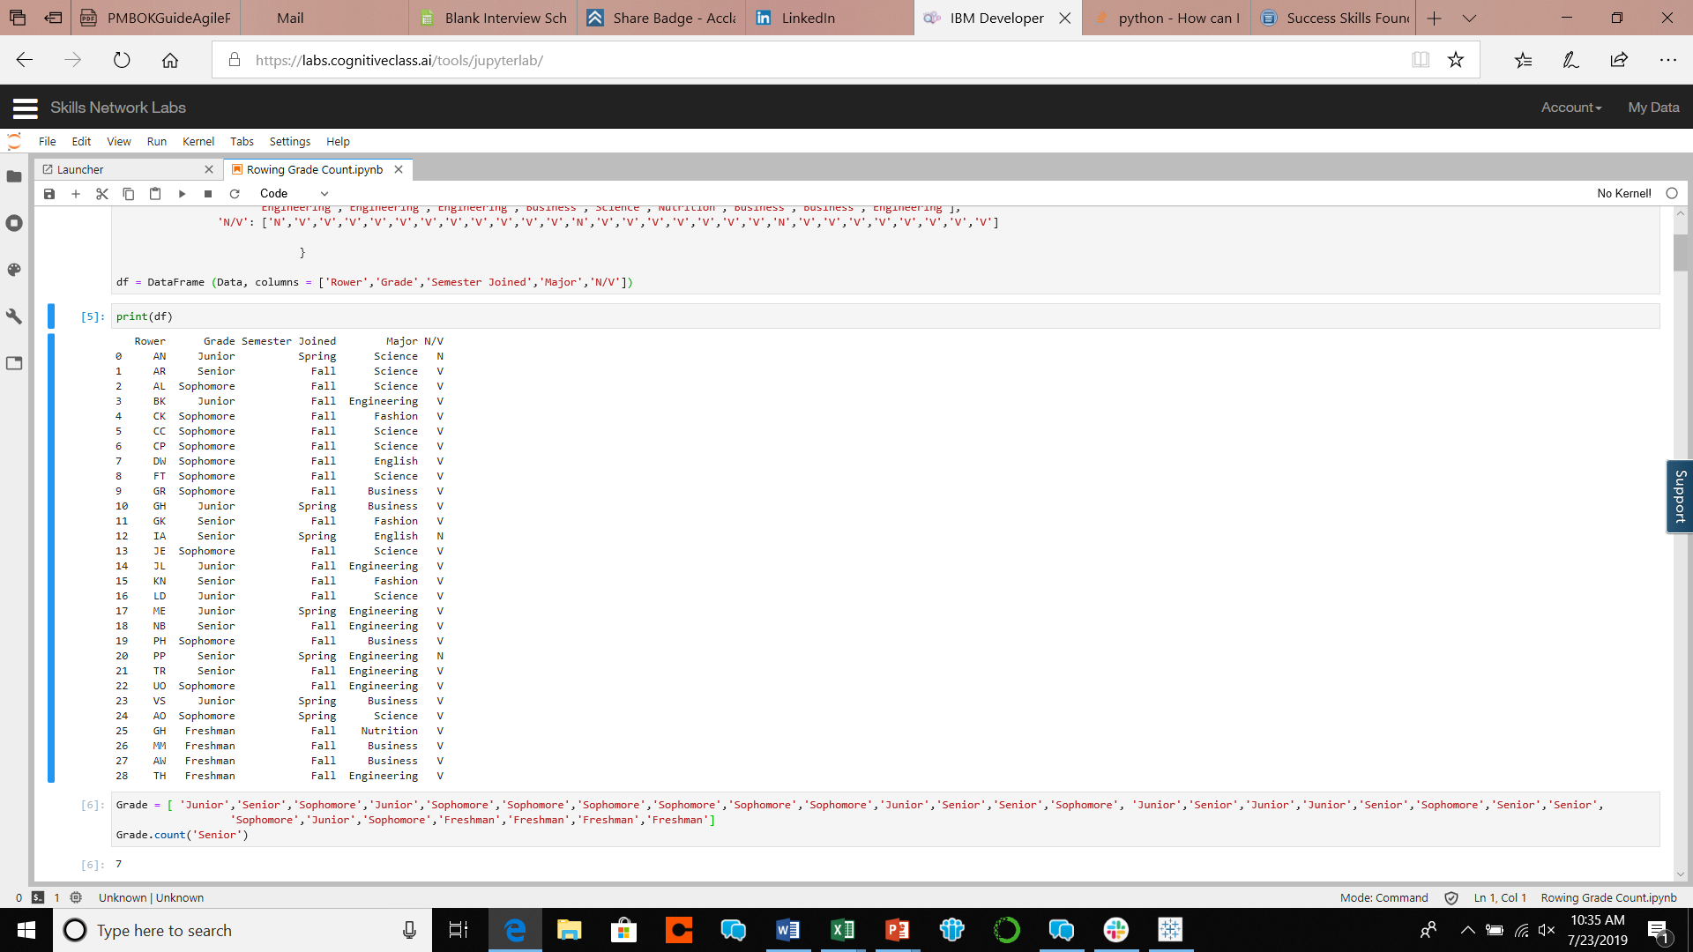
Loaded the data into Python

Slide 4
When do most members join in their college career?

Slide 5
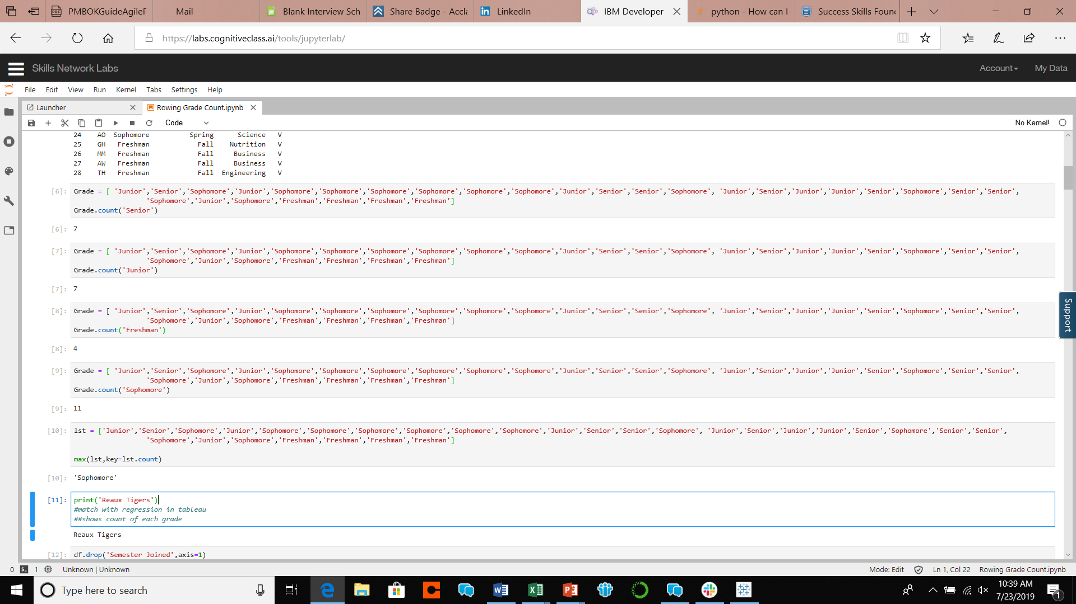
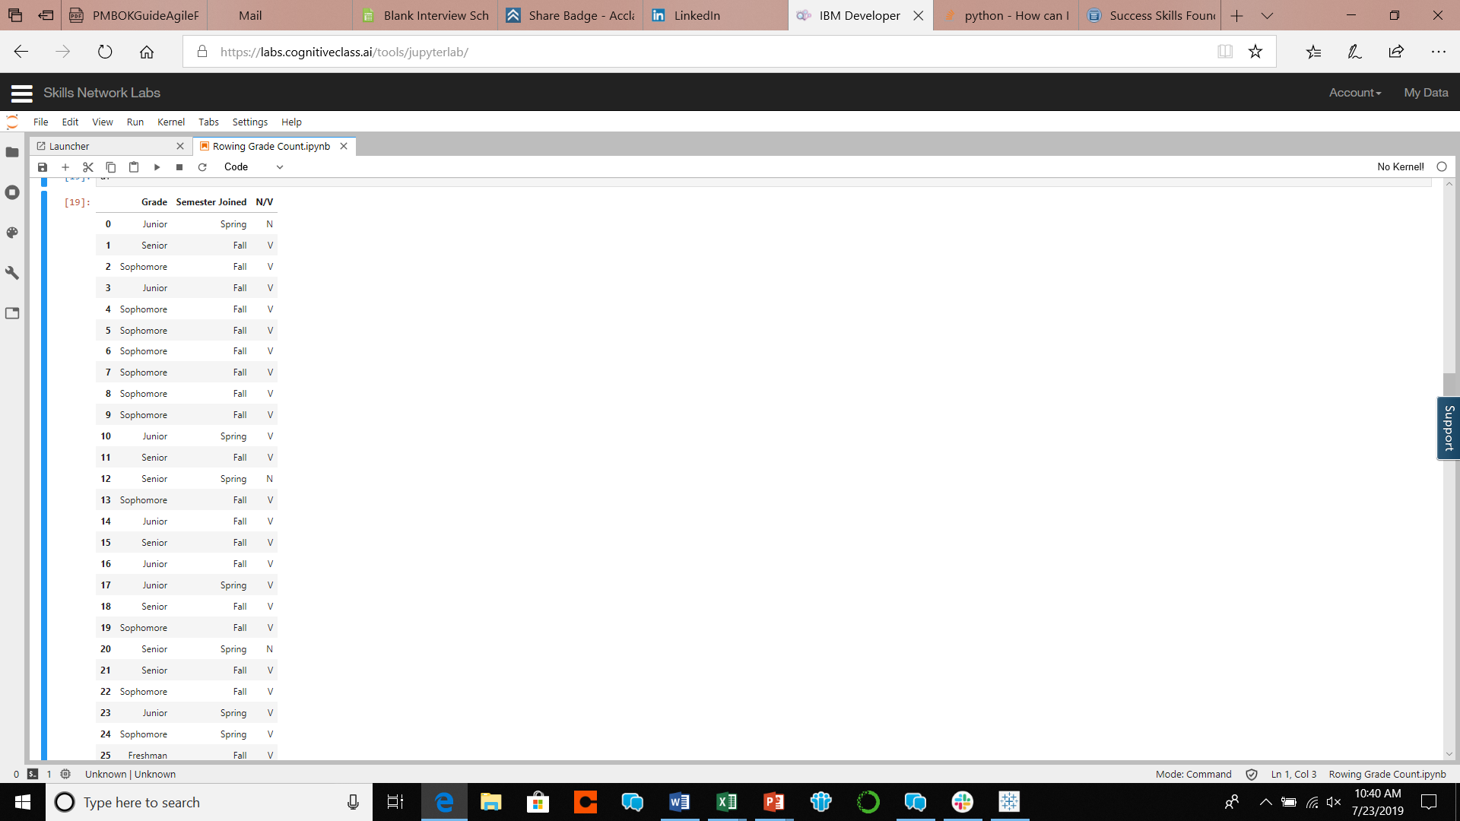
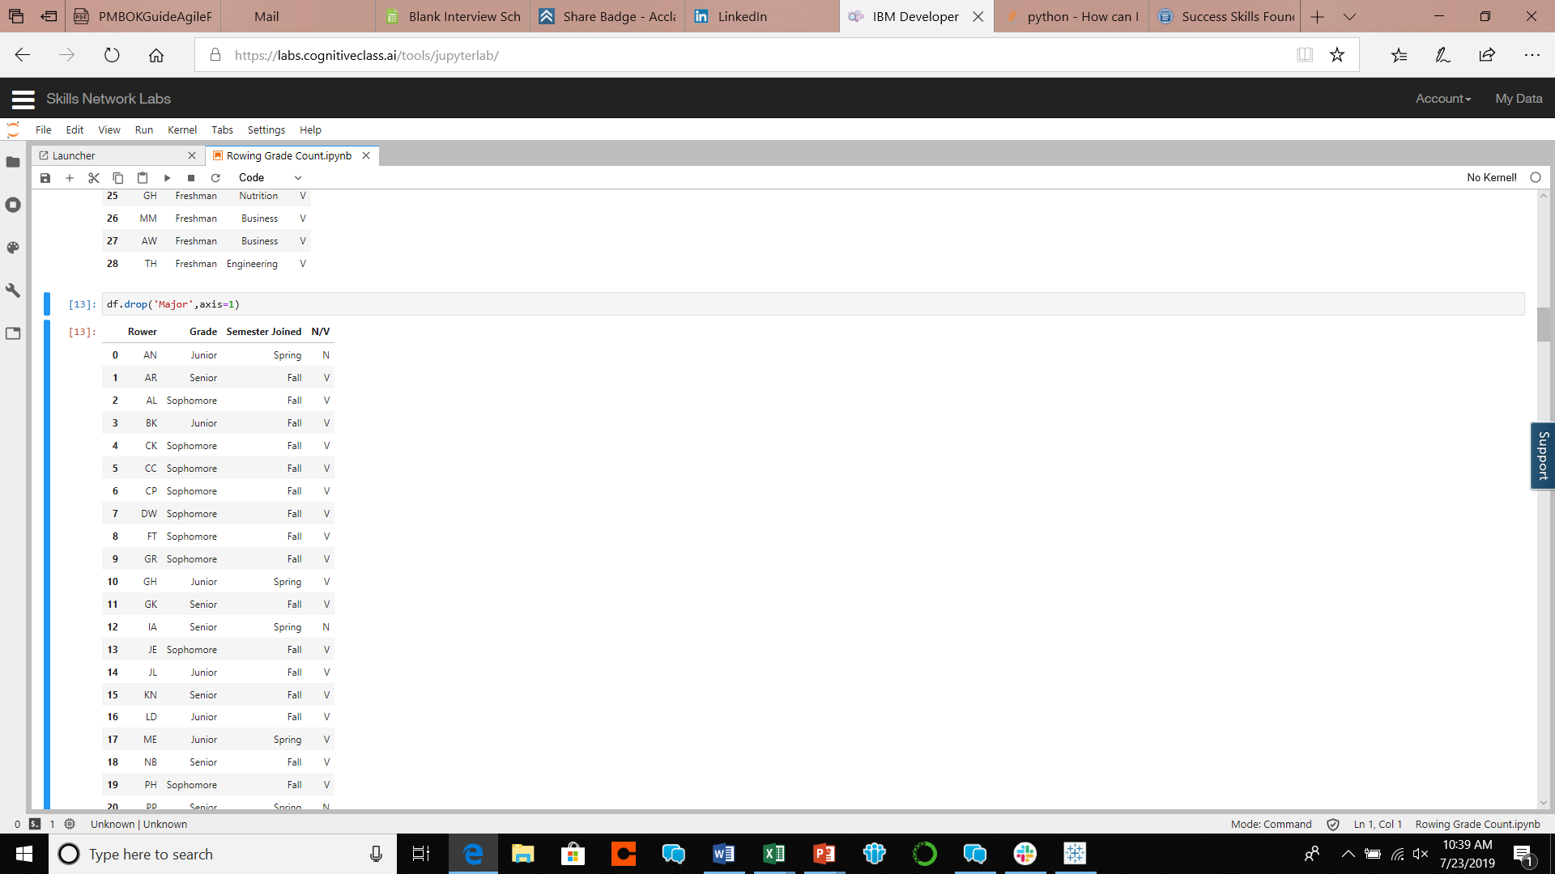
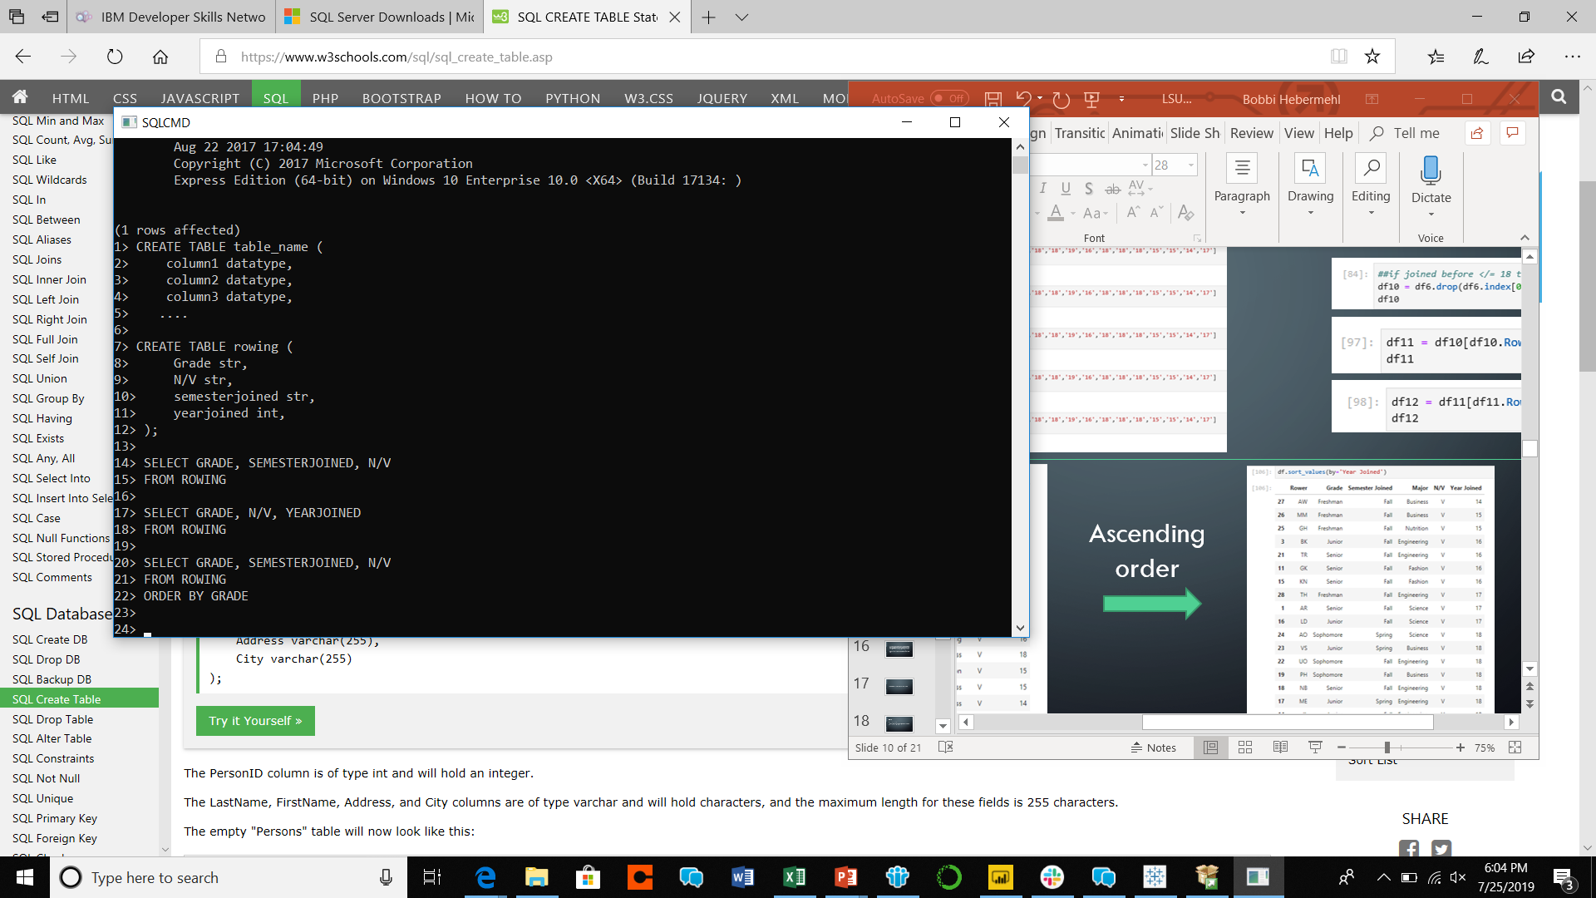
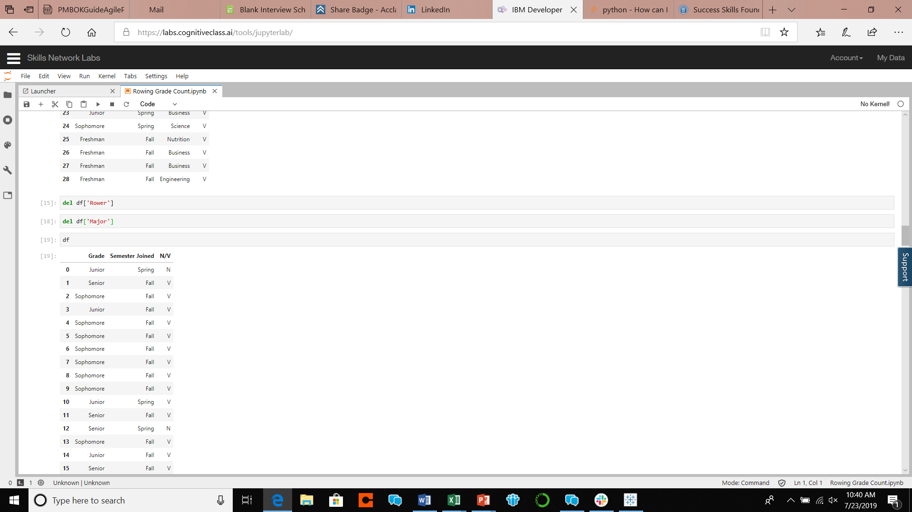
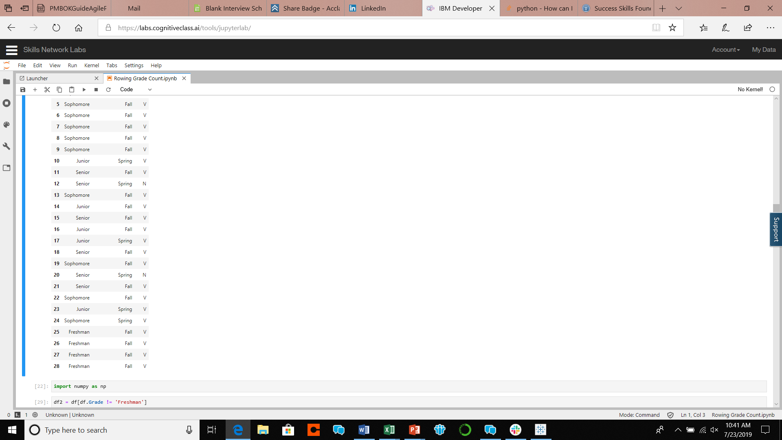
Took the count of each Grade
Deleted non-relevant columns…
In Python and in SQL

Slide 6

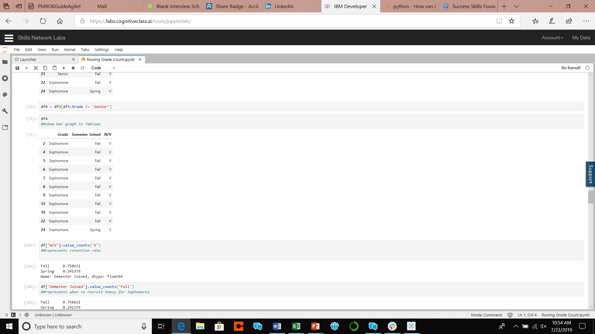
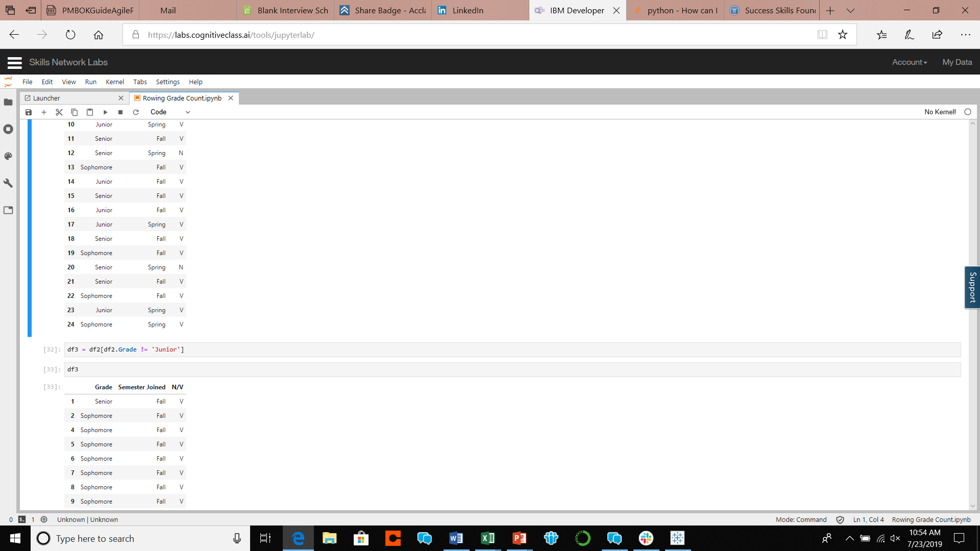
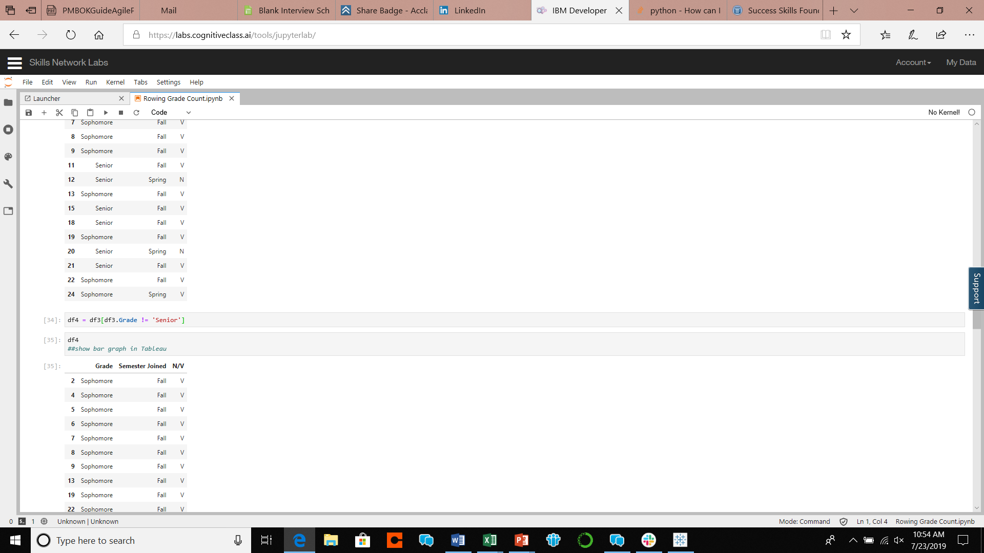
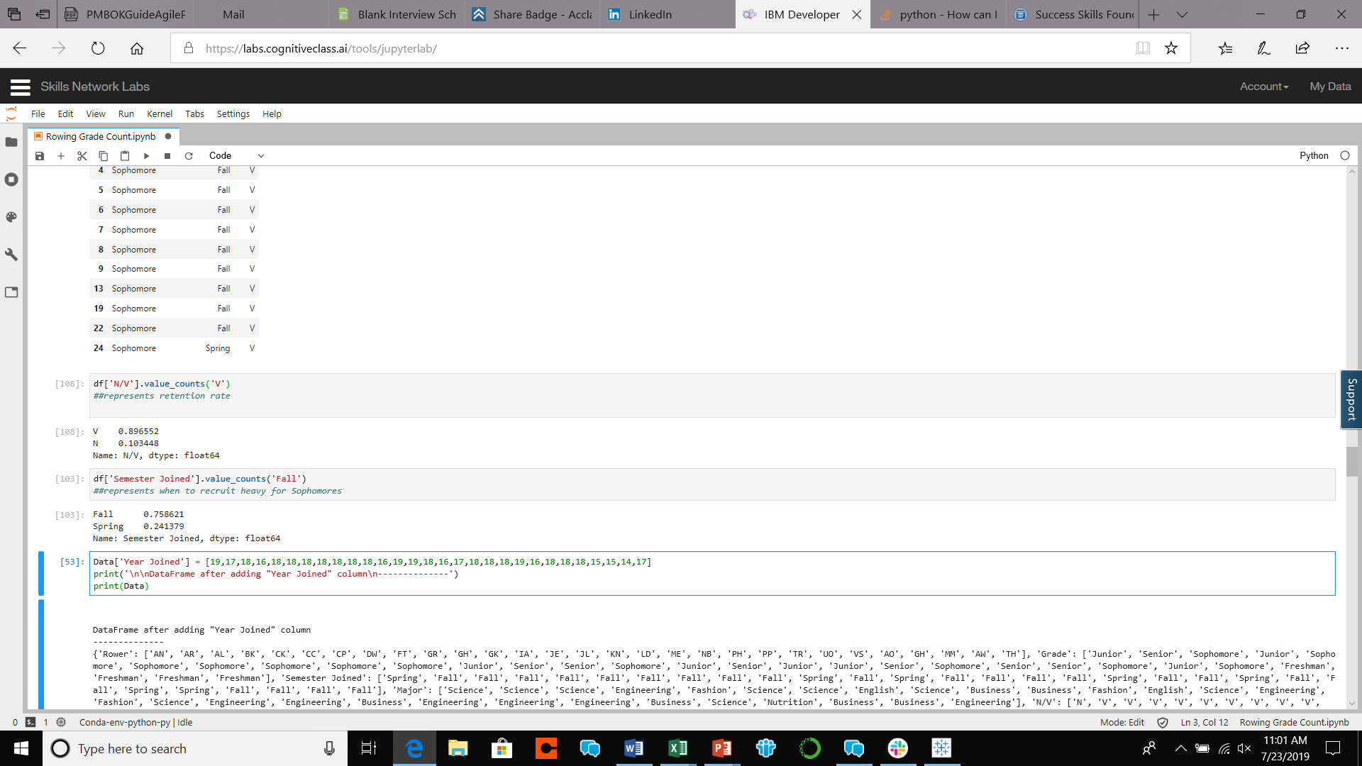
Deleted non-relevant information…in Python and in SQL
Took statistics to determine team retention

Slide 7
Fall Sophomores
After taking the count of each grade I discovered Sophomore year is the year most people join the team. Though what matters is that they stick around and not just join. Once I narrowed the table to only sophomores, I took the ratio of those members that were Novice(on the team for one year) or Varsity(has been on the team for longer than a year) to determine our retention rate. Varsity came out with a greater retention rate of .89, or 89%, which shows us that members who join Sophomore year are most likely to stay longer than a year. I also determined the retention rate for Sophomores who joined in the Fall or Spring. The Fall had a retention rate of about a .76, or 76%, showing us that members who join in the Fall are more likely to stay for longer than a year.

Slide 8
How long do members stay?

Slide 9
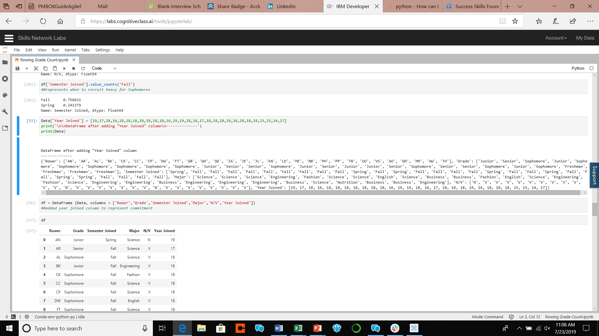

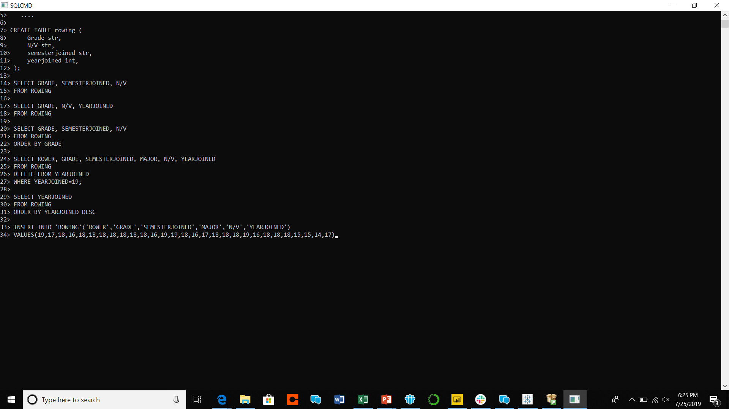
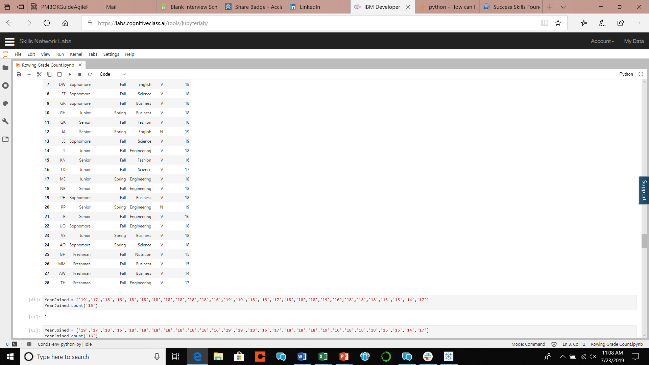
Added a column of information…
in Python
and in SQL

Slide 10
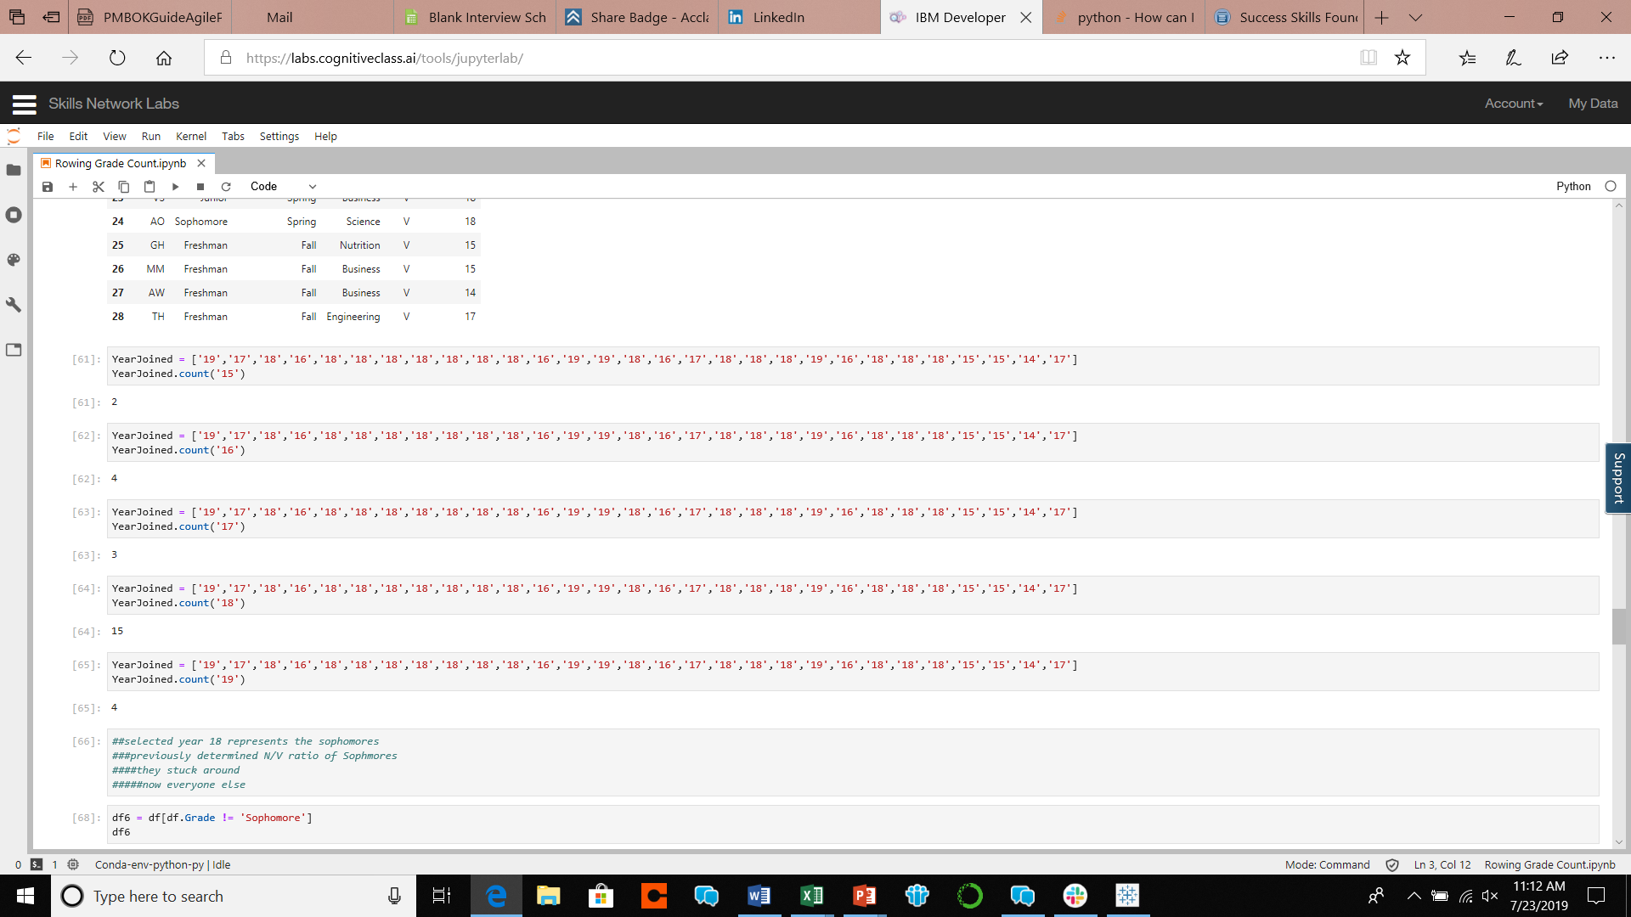
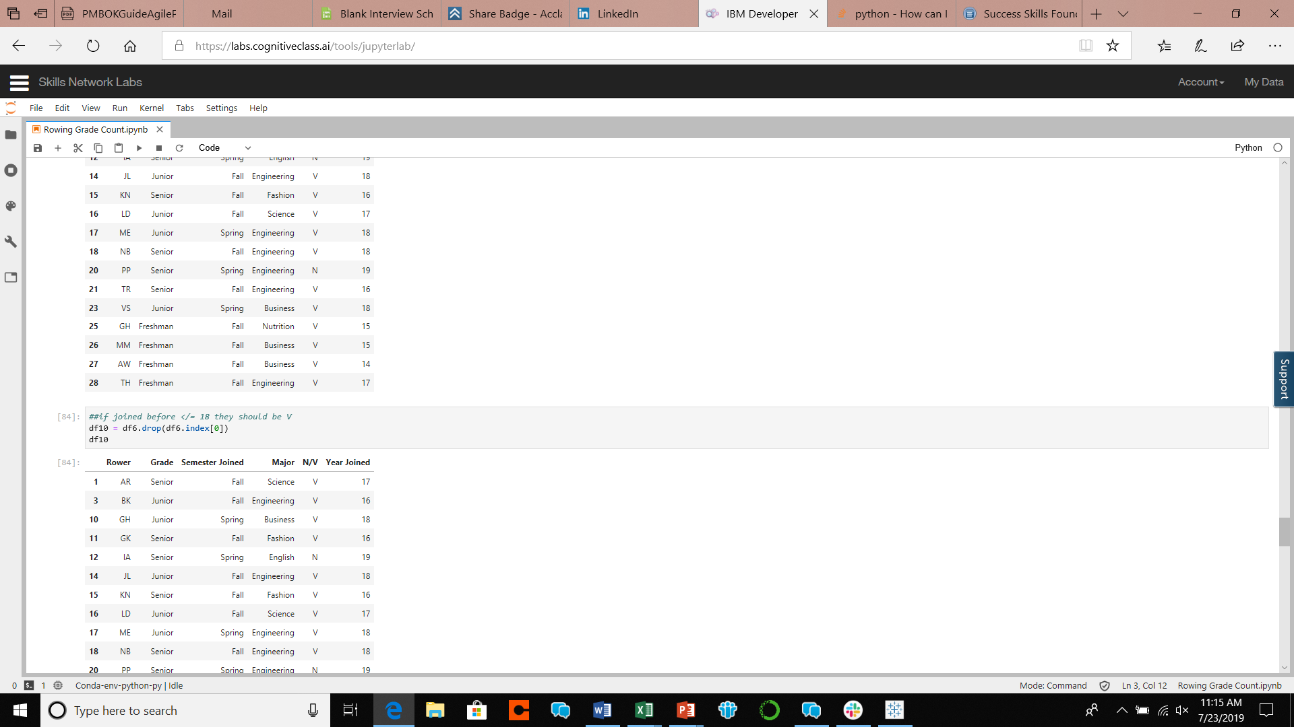


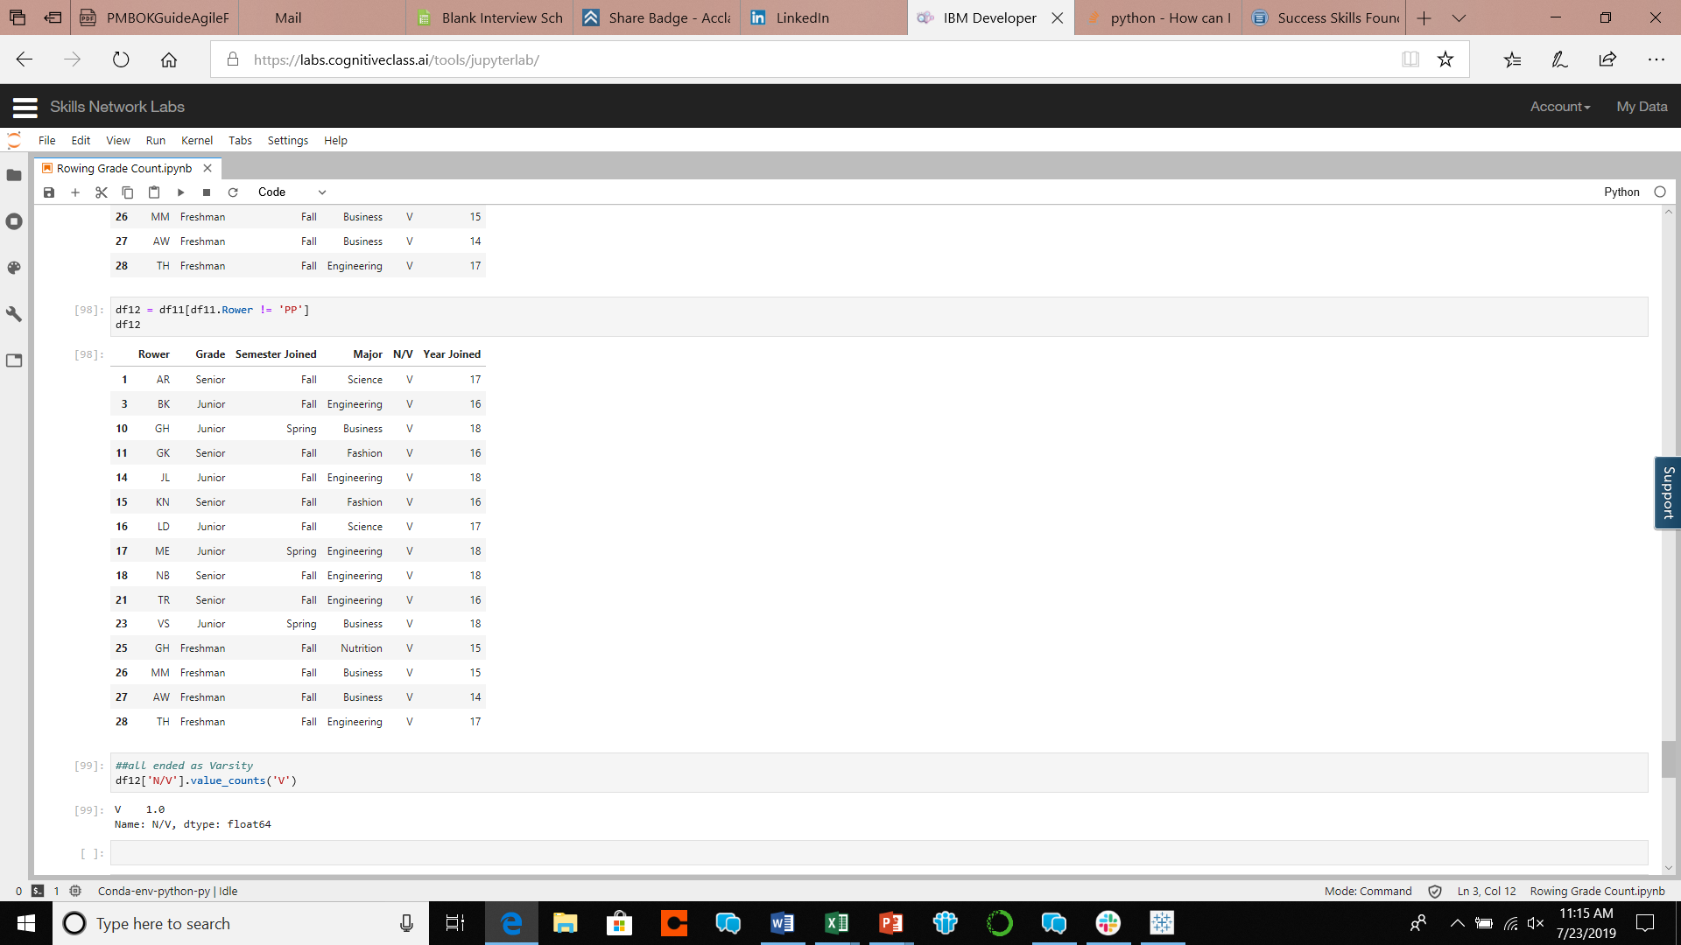

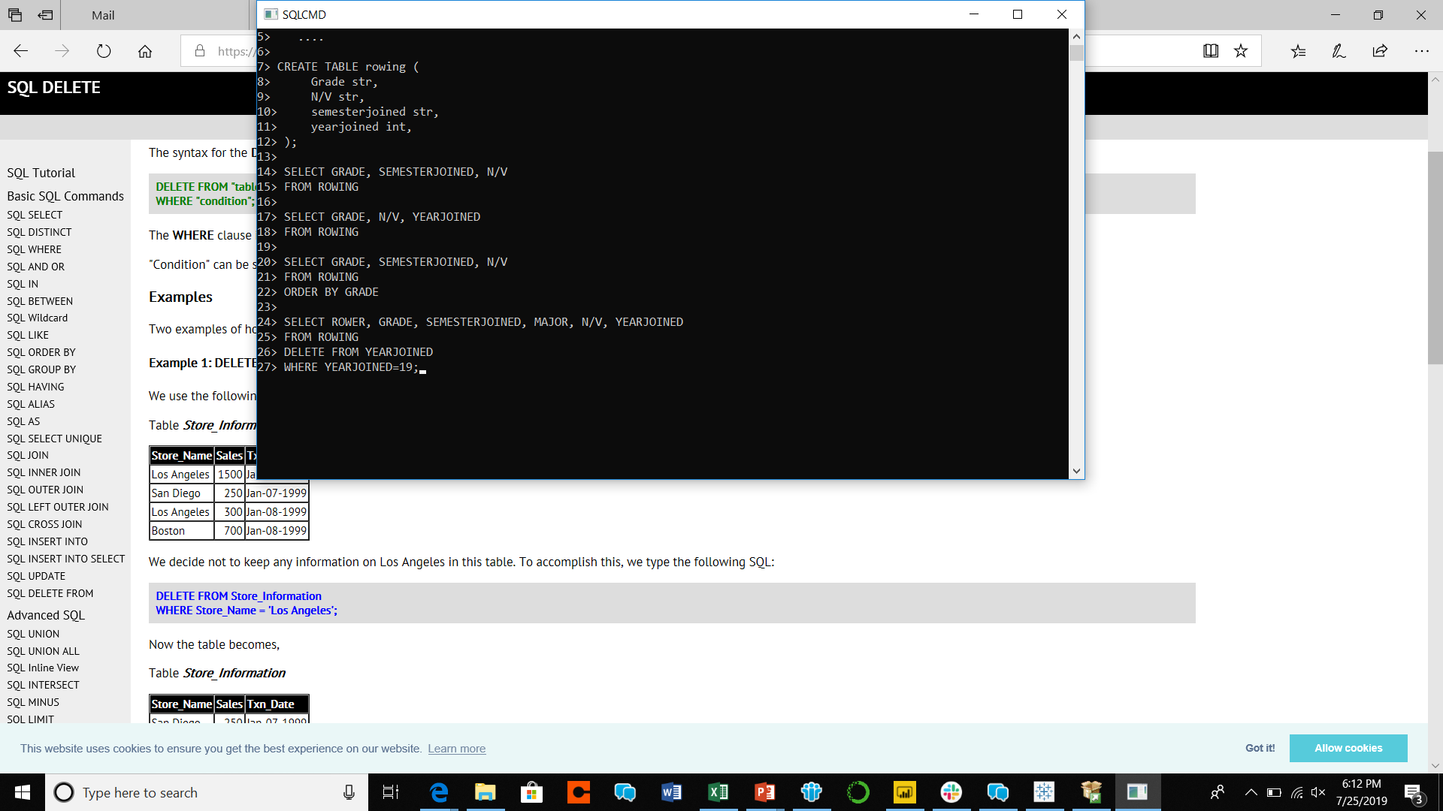
Took the counts of each year
Deleted non-relevant information…
in Python
and in SQL
Ascending order

Slide 11
After taking the count of the year each member joined I established each year we grew. Though after compiling all the information for members who joined before 2019, you can see that our retention rate is 100%. All the members stayed until they were Varsity and longer. This shows that our problem doesn’t lie in keeping members, because our results prove that most of the time our members will stay once they join.

Slide 12
Does Lsu rowing have a reasonable budget?

Slide 13
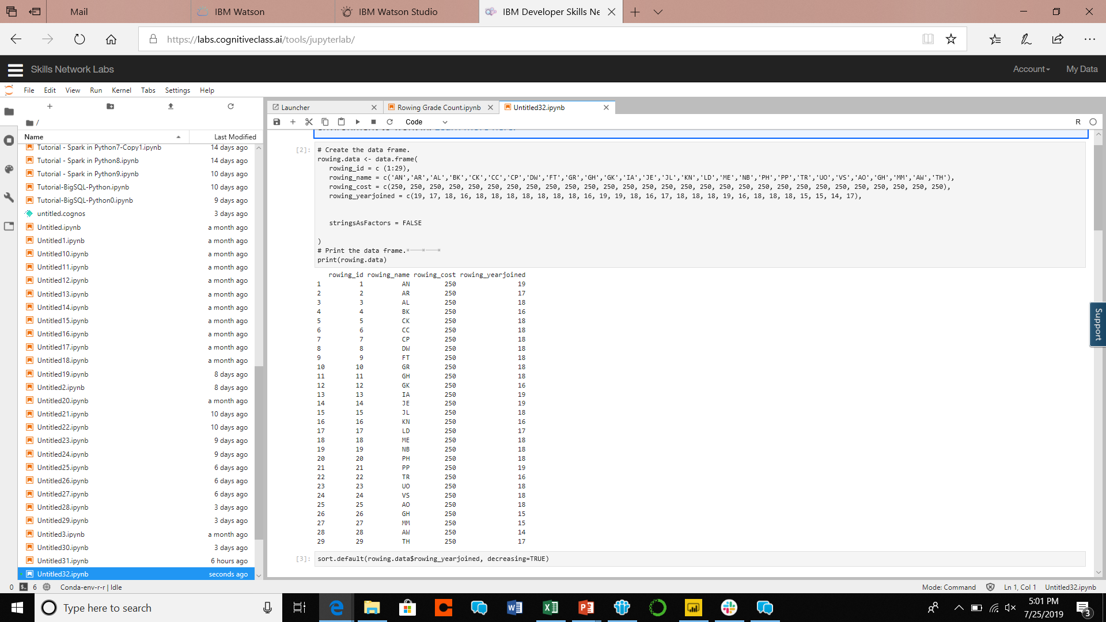
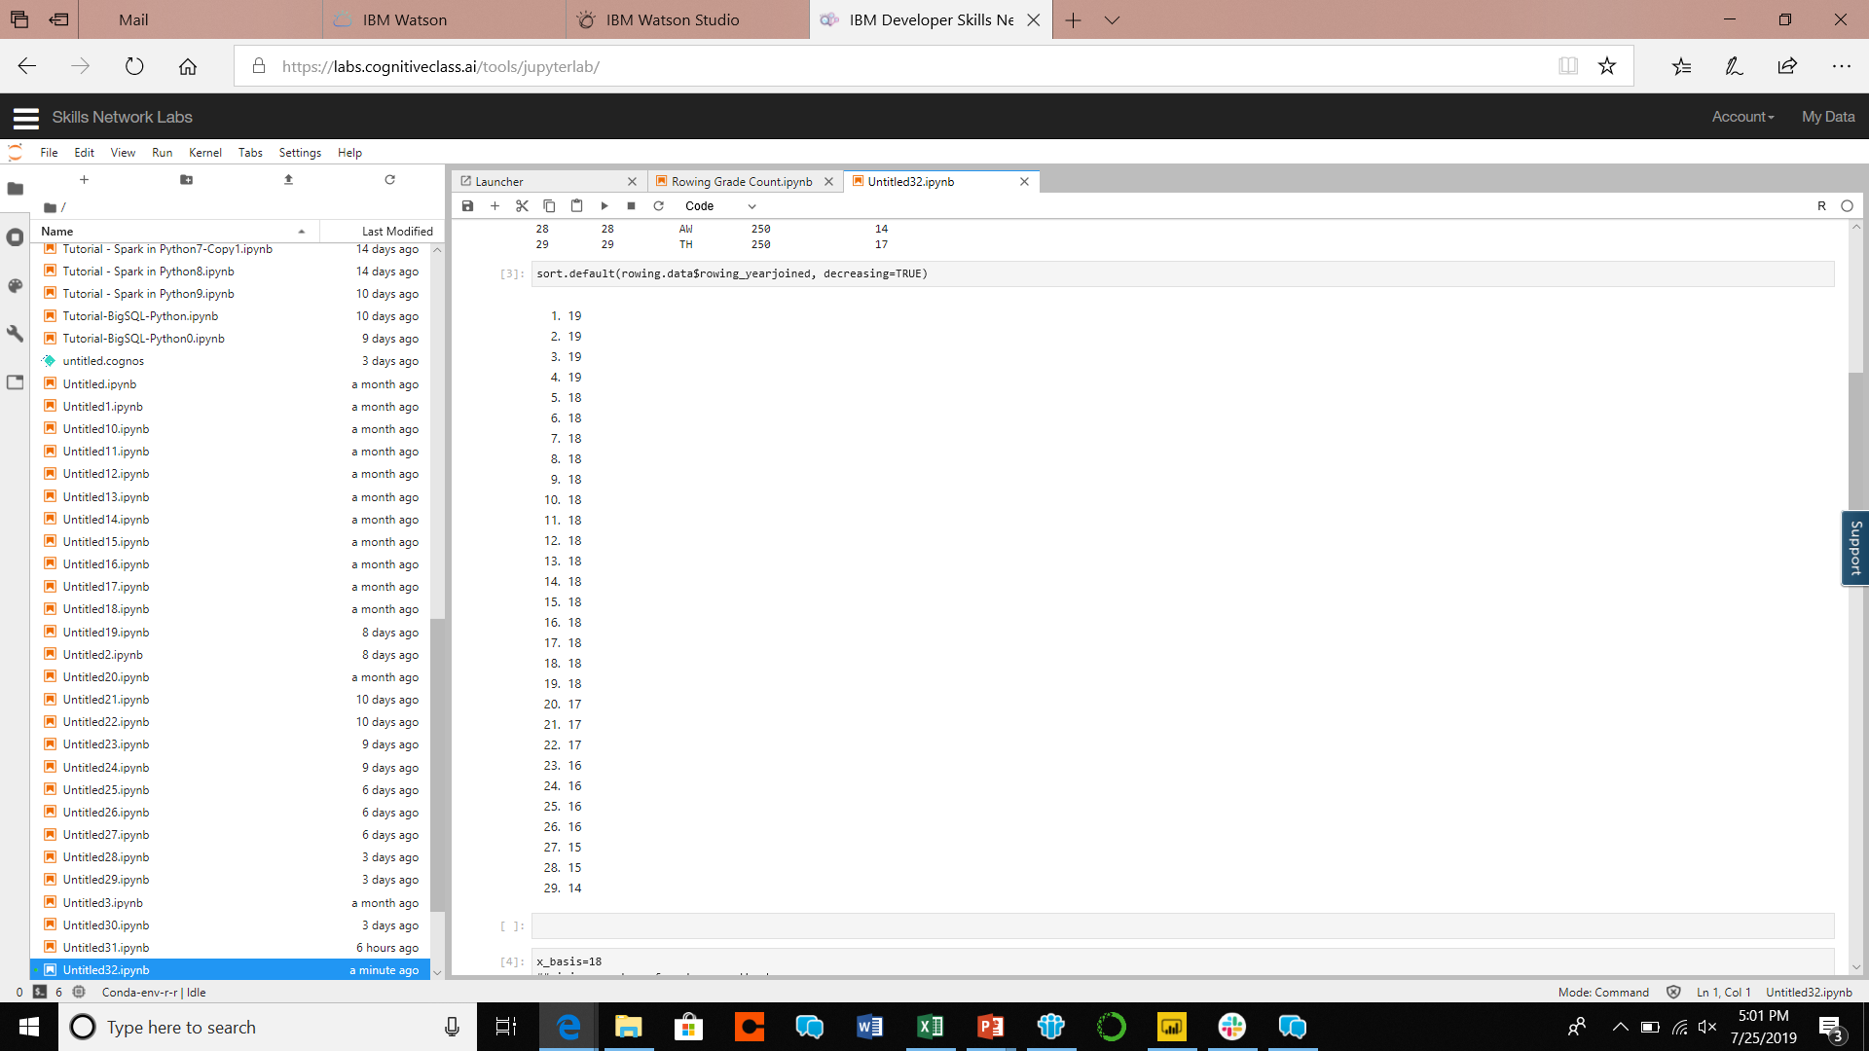
Loaded appropriate data into R
Placed Year Joined column into descending order…
in R
And in SQL

Slide 14

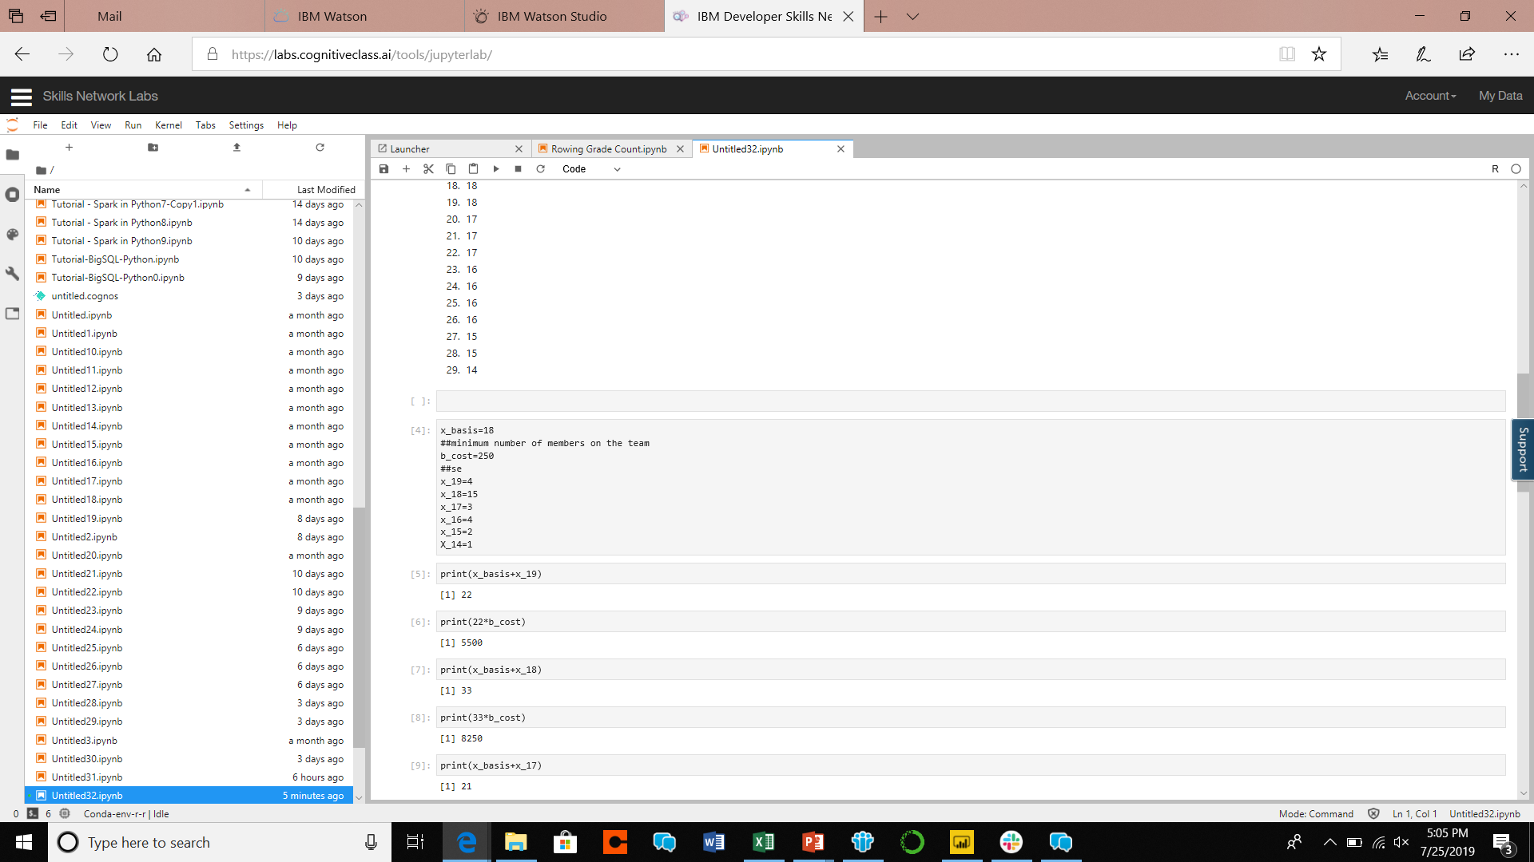
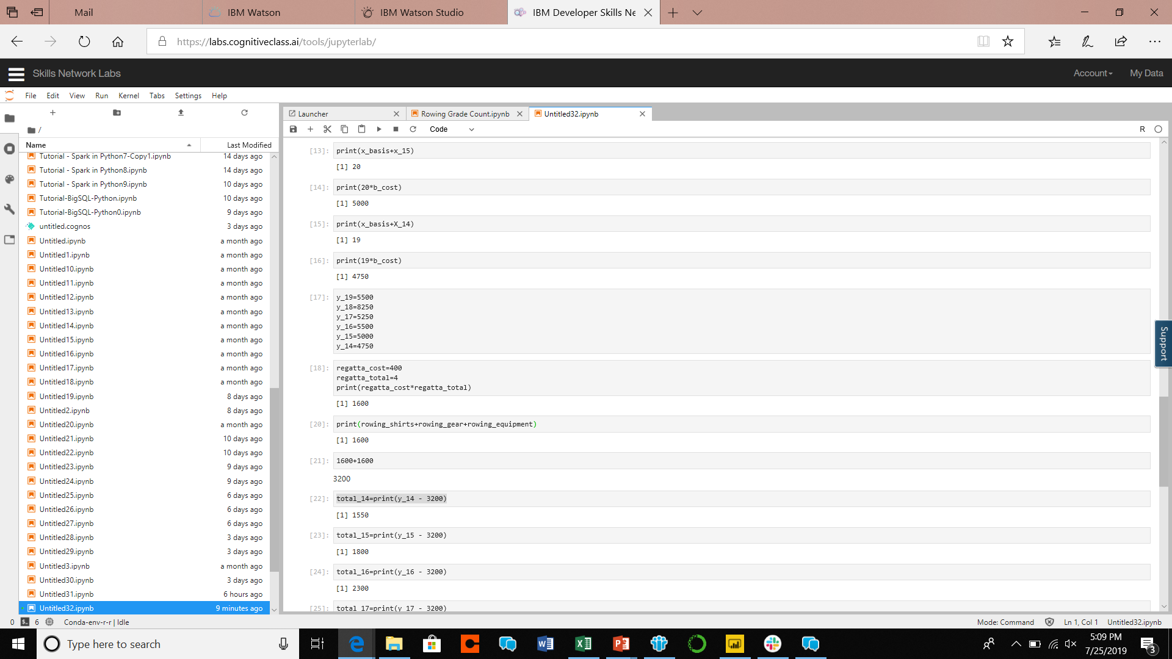
Took the count of each year
Added our minimum amount of team members(x_basis) and the number of people who joined each year
Took that result and multiplied it by the semester cost per member(b_cost)
Results of semesterly income

Slide 15

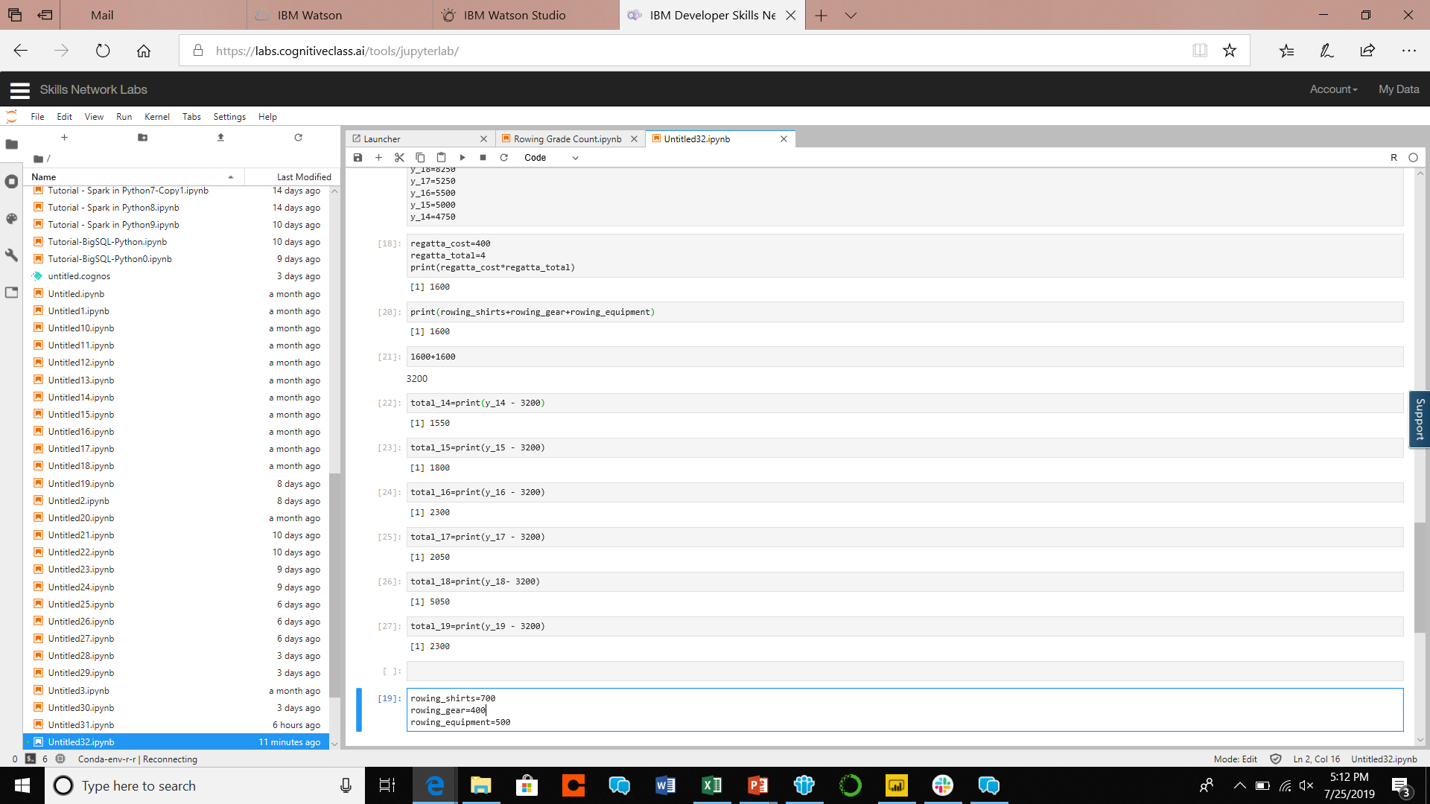
Inserted required semesterly costs
Determined how much we spend on regattas semesterly
Subtracted that result from our semesterly income

Slide 16
After determining how much we make a semester from members paying their required dues and how much we have to pay in order for us to stay afloat, we determined LSU Rowings net income has relatively been increasing over the years. This proves that our problem doesn’t lie in operating costs, but more so in recruiting. The results showed in 2018 that we had a larger margin of safety than in the past. The members that joined that year was at an all time high of 15.

Slide 17
Where does LSU Rowing go from here?

Slide 18
Results
Majority of members join their Sophomore year
Majority of members who stay longer than a year joined their Fall Semester
Majority of members stay throughout their college career

Slide 19
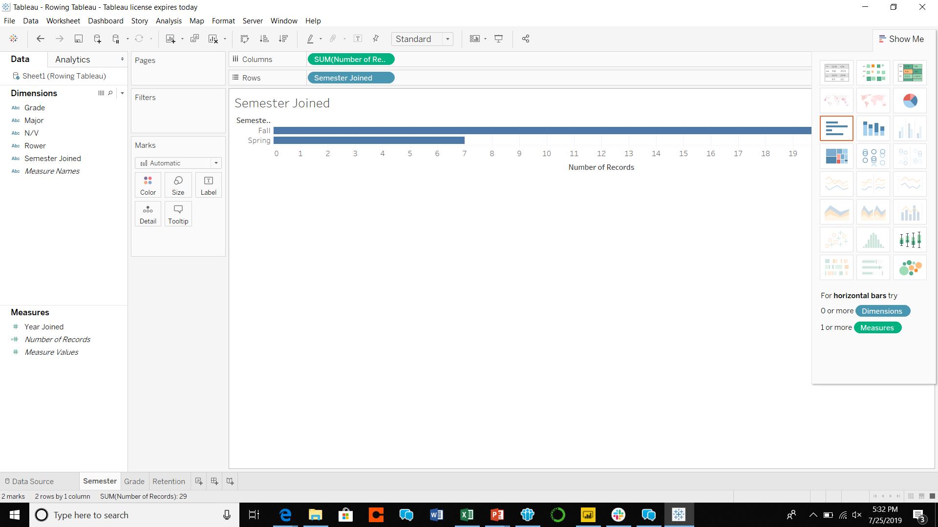
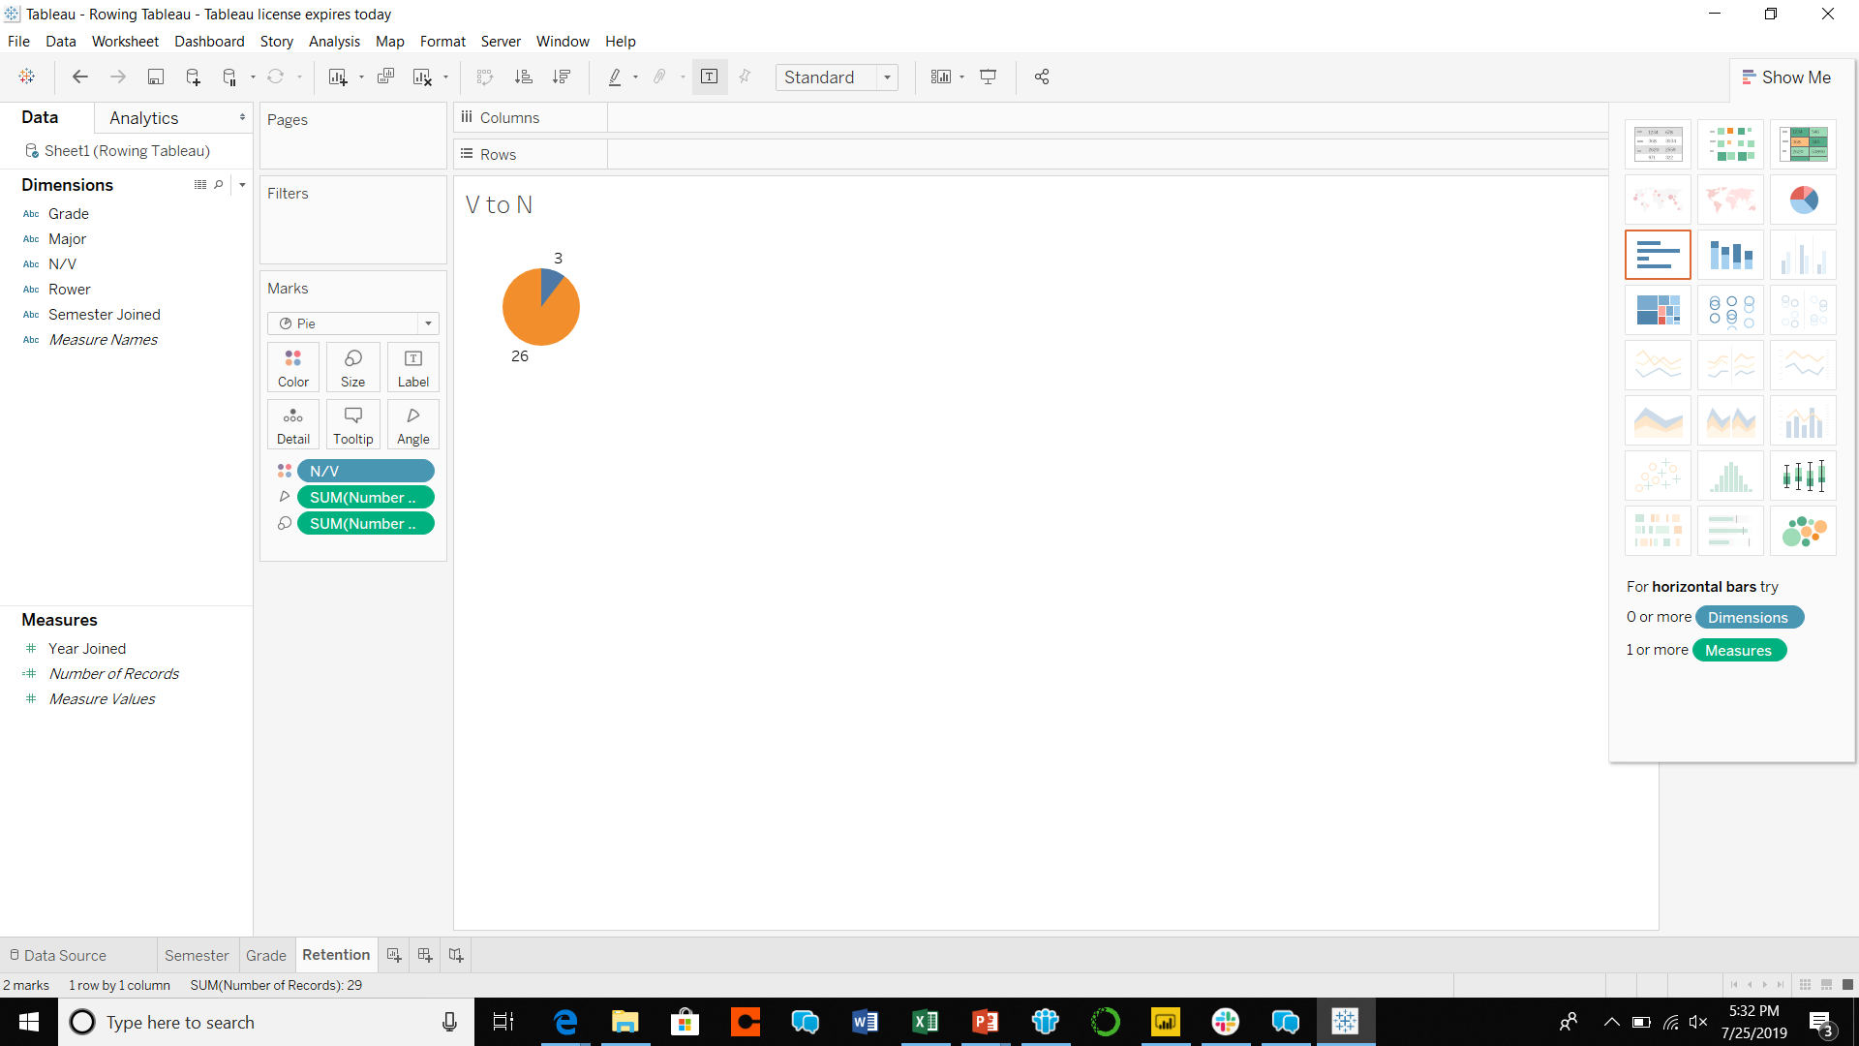
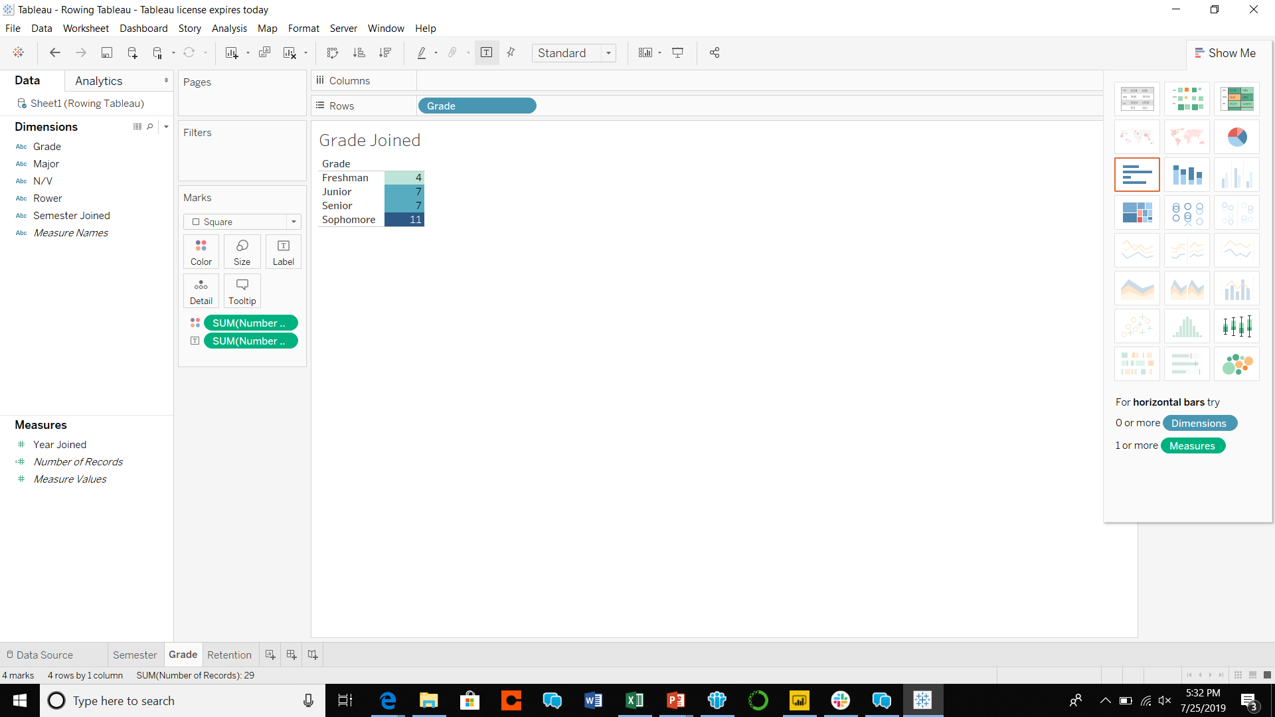
How do we hold this to be true?
Displayed results in Tableau

Slide 20
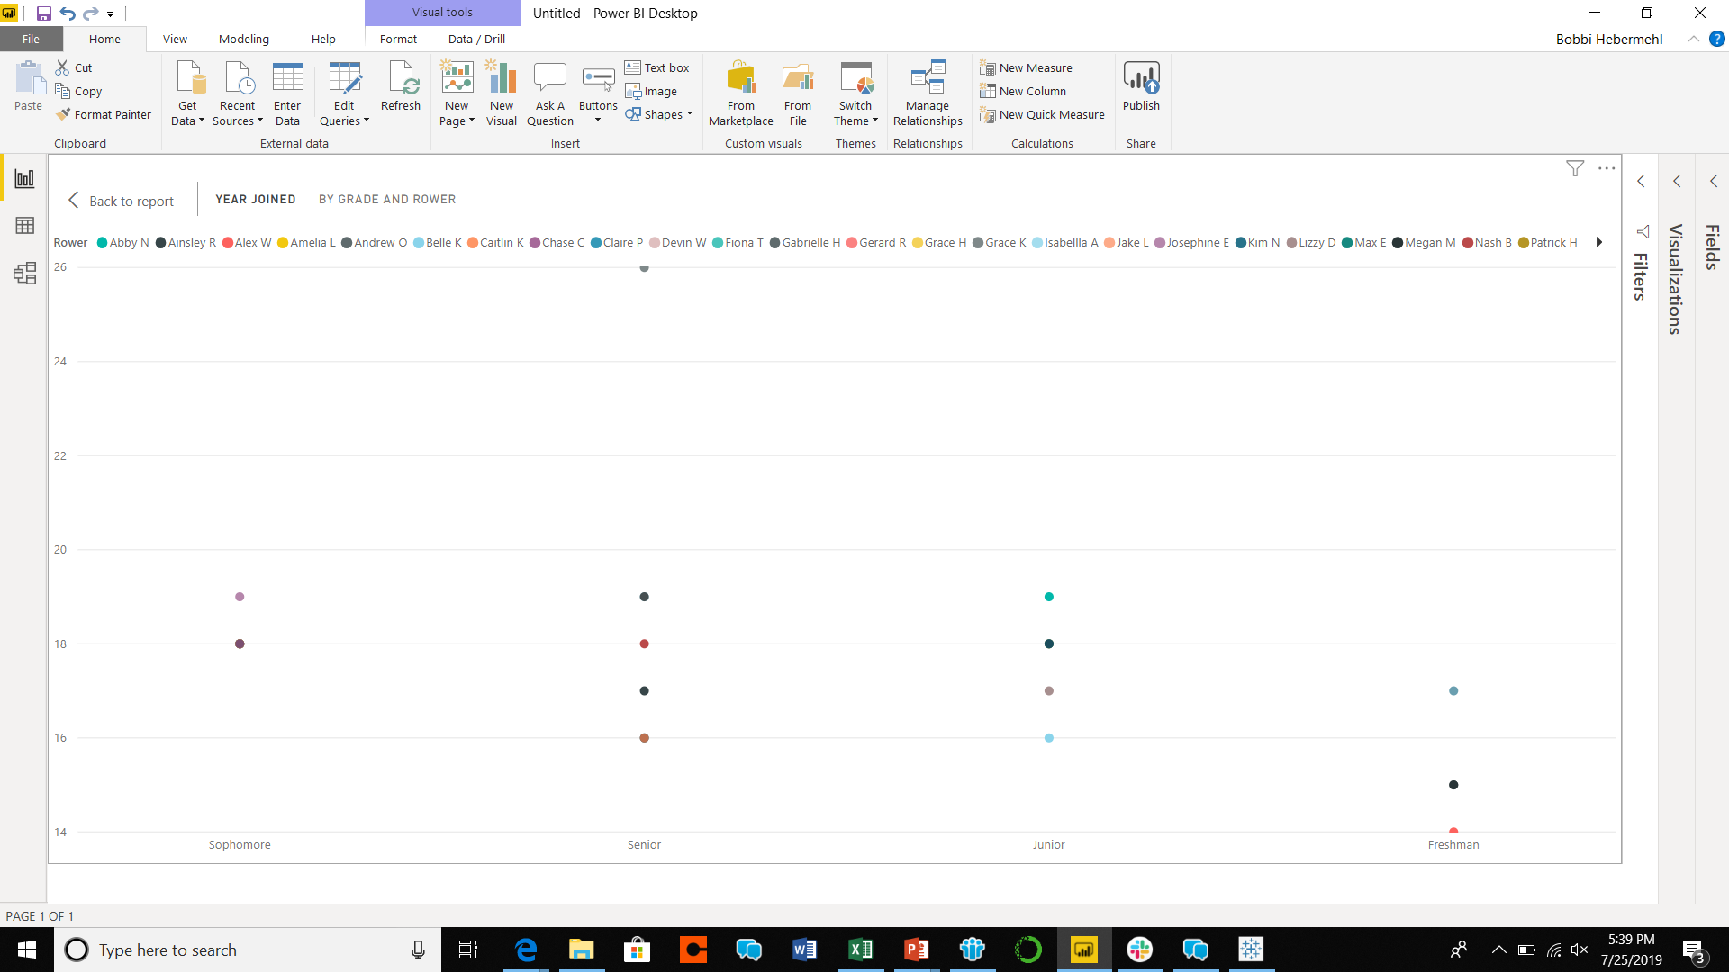
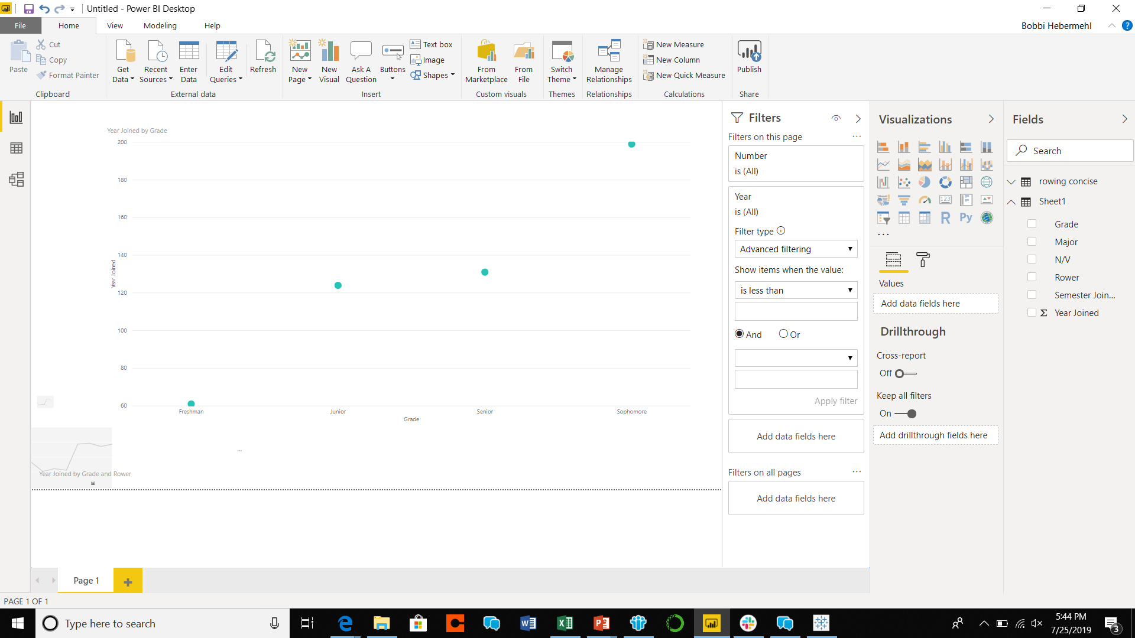
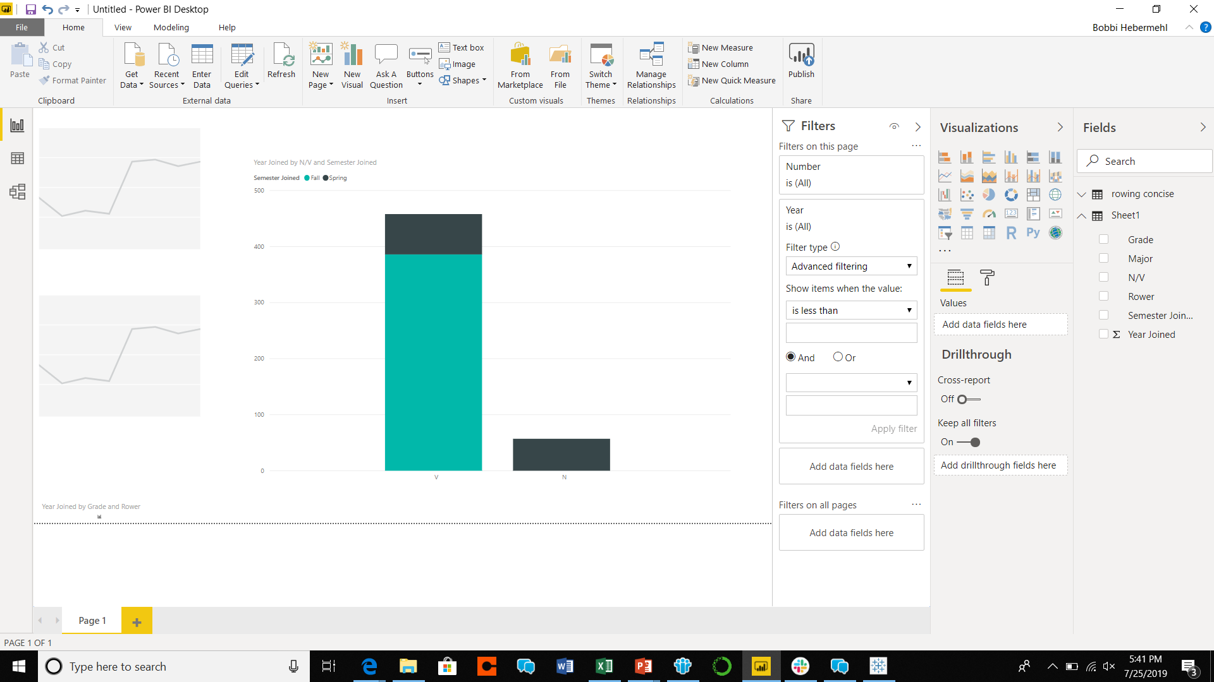
Displayed results in PowerBi

Slide 21
What does LSU Rowing Do now?
Recruit in Sophomore populated areas
Continue recruiting leading up to the fall and during the fall
Recruit heavily in the spring to increase revenues coming in to help recruiting costs in the fal
Maintain semesterly costs

Slide 22
Thank you for viewing
Analysis and visualizing done By: bobbi hebermehl

